Slide 1
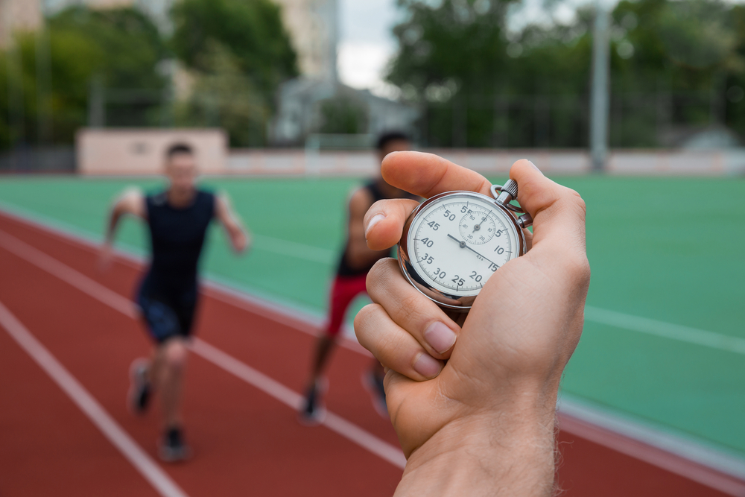
BTEC Tech Award Sport – Component 3
Learning outcome B: Investigate fitness testing to determine fitness levels
B1 Importance of fitness testing and requirements for administration of each fitness test
You will learn about:
Reasons for fitness testing
Pre-test procedures
How to select and carry out a range of fitness tests
Validity, reliability and practicality of each test
Notes:
Text, design and layout © Eboru Publishing
Images are © Shutterstock and licensed from shutterstock.com for use within the PowerPoint, by the purchasing institution only.
Unauthorised distribution of text, slides or images outside the institution is strictly prohibited.

Slide 2
Reasons for fitness testing
Used for baseline data - this shows how fit or skilled a competitor is at the start of training
The results of tests are used to design training plans
Regular testing can check if training is working

Slide 3
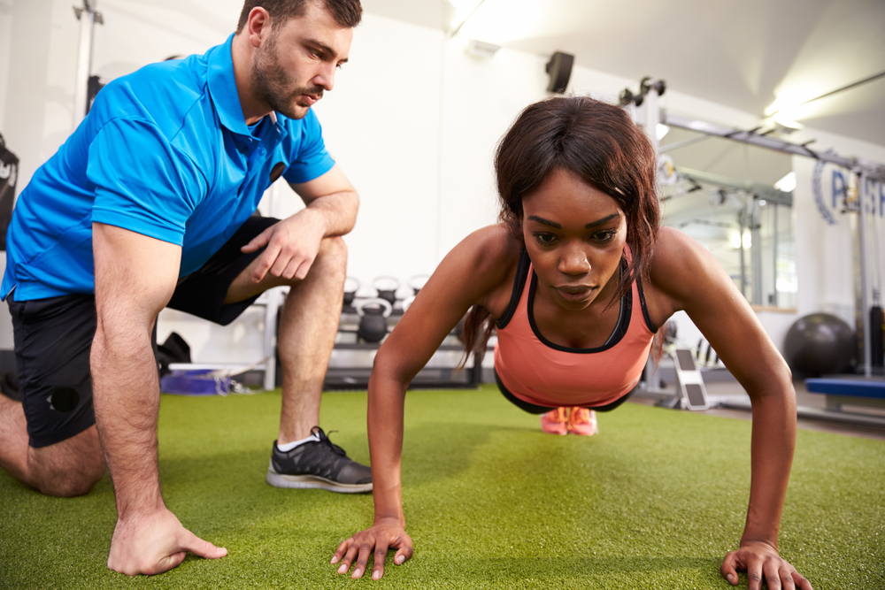
Reasons for fitness testing
Knowing they will be tested gives performers something to aim for during training
Testing can be used to set specific goals – such as “do 15 press-ups in a minute”

Slide 4
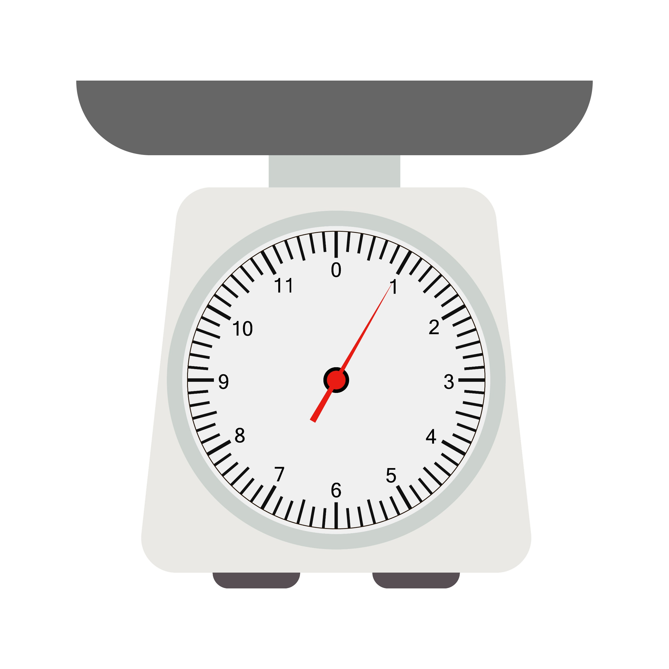
Pre-test procedures
Calibrate equipment
Calibrate means:
Checking that readings start at zero
Checking the readings against some other equipment that is known to give the right results
Equipment that has not been calibrated may give incorrect results.
These weighing scales are reading 1kg even though there is nothing on them. These scales need to be calibrated to give the right reading.

Slide 5
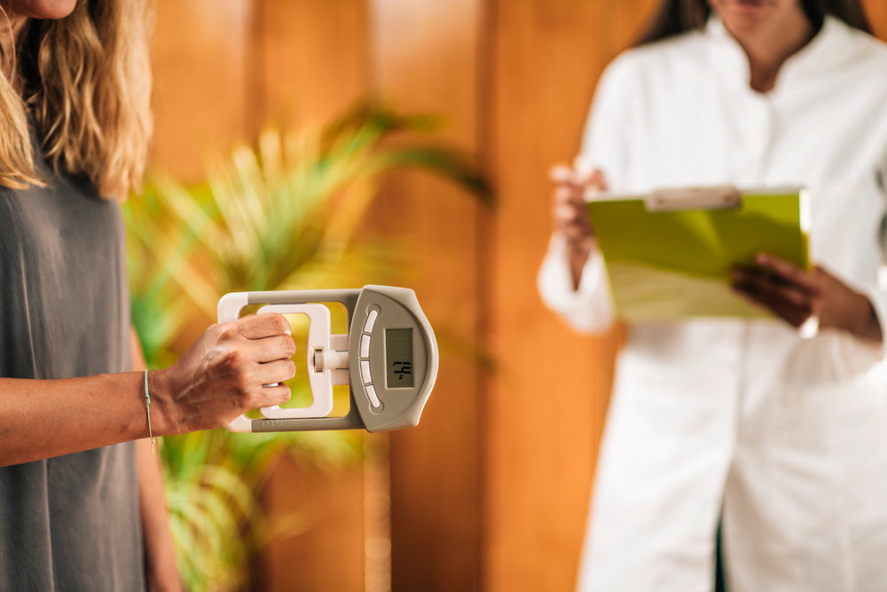
Pre-test procedures
Calibrate equipment
Watch this video about calibrating skin-fold callipers.
You don’t need to know about skin fold callipers, but the advice about calibration is relevant to all equipment.
Here’s a different example showing how you could check and calibrate a hand-grip dynamometer.

Slide 6
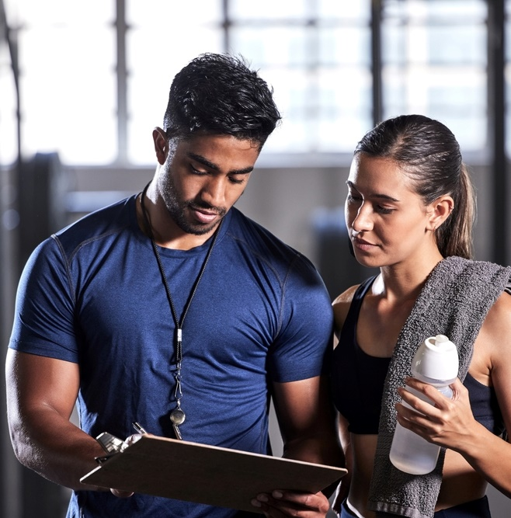
Pre-test procedures
1
Participant forms and checks
Participant must :
sign an Informed Consent Form to show they understand what they need to do and the risks involved
sign a PAR-Q form which checks if they have any medical conditions
carry out a pre-fitness check – this allows the trainer to understand the participant’s level of fitness, lifestyle, and any other factors that might affect the test that day

Slide 7
Pre-test procedures
1
Participant forms and checks
This video runs through some sample PAR-Q question.
Note that there is no standard list of questions….
…but the PAR-Q is meant to make sure that exercise will not be dangerous or likely to cause injury to someone.
(PAR-Q stands for Physical Activity Readiness Questionnaire).

Slide 8
Conducting fitness tests
1
There are a few things we need to do to run a fitness test.
Before the test you need to:
Know what tests are available to you
Select the right fitness test for that performer, their given sport and component of fitness
Know the standard test method for the selected test

Slide 9
Conducting fitness tests
1
During the test you need to:
Carefully take readings
Write readings down, using correct units
After the test you need to:
Interpret the results using published data

Slide 10
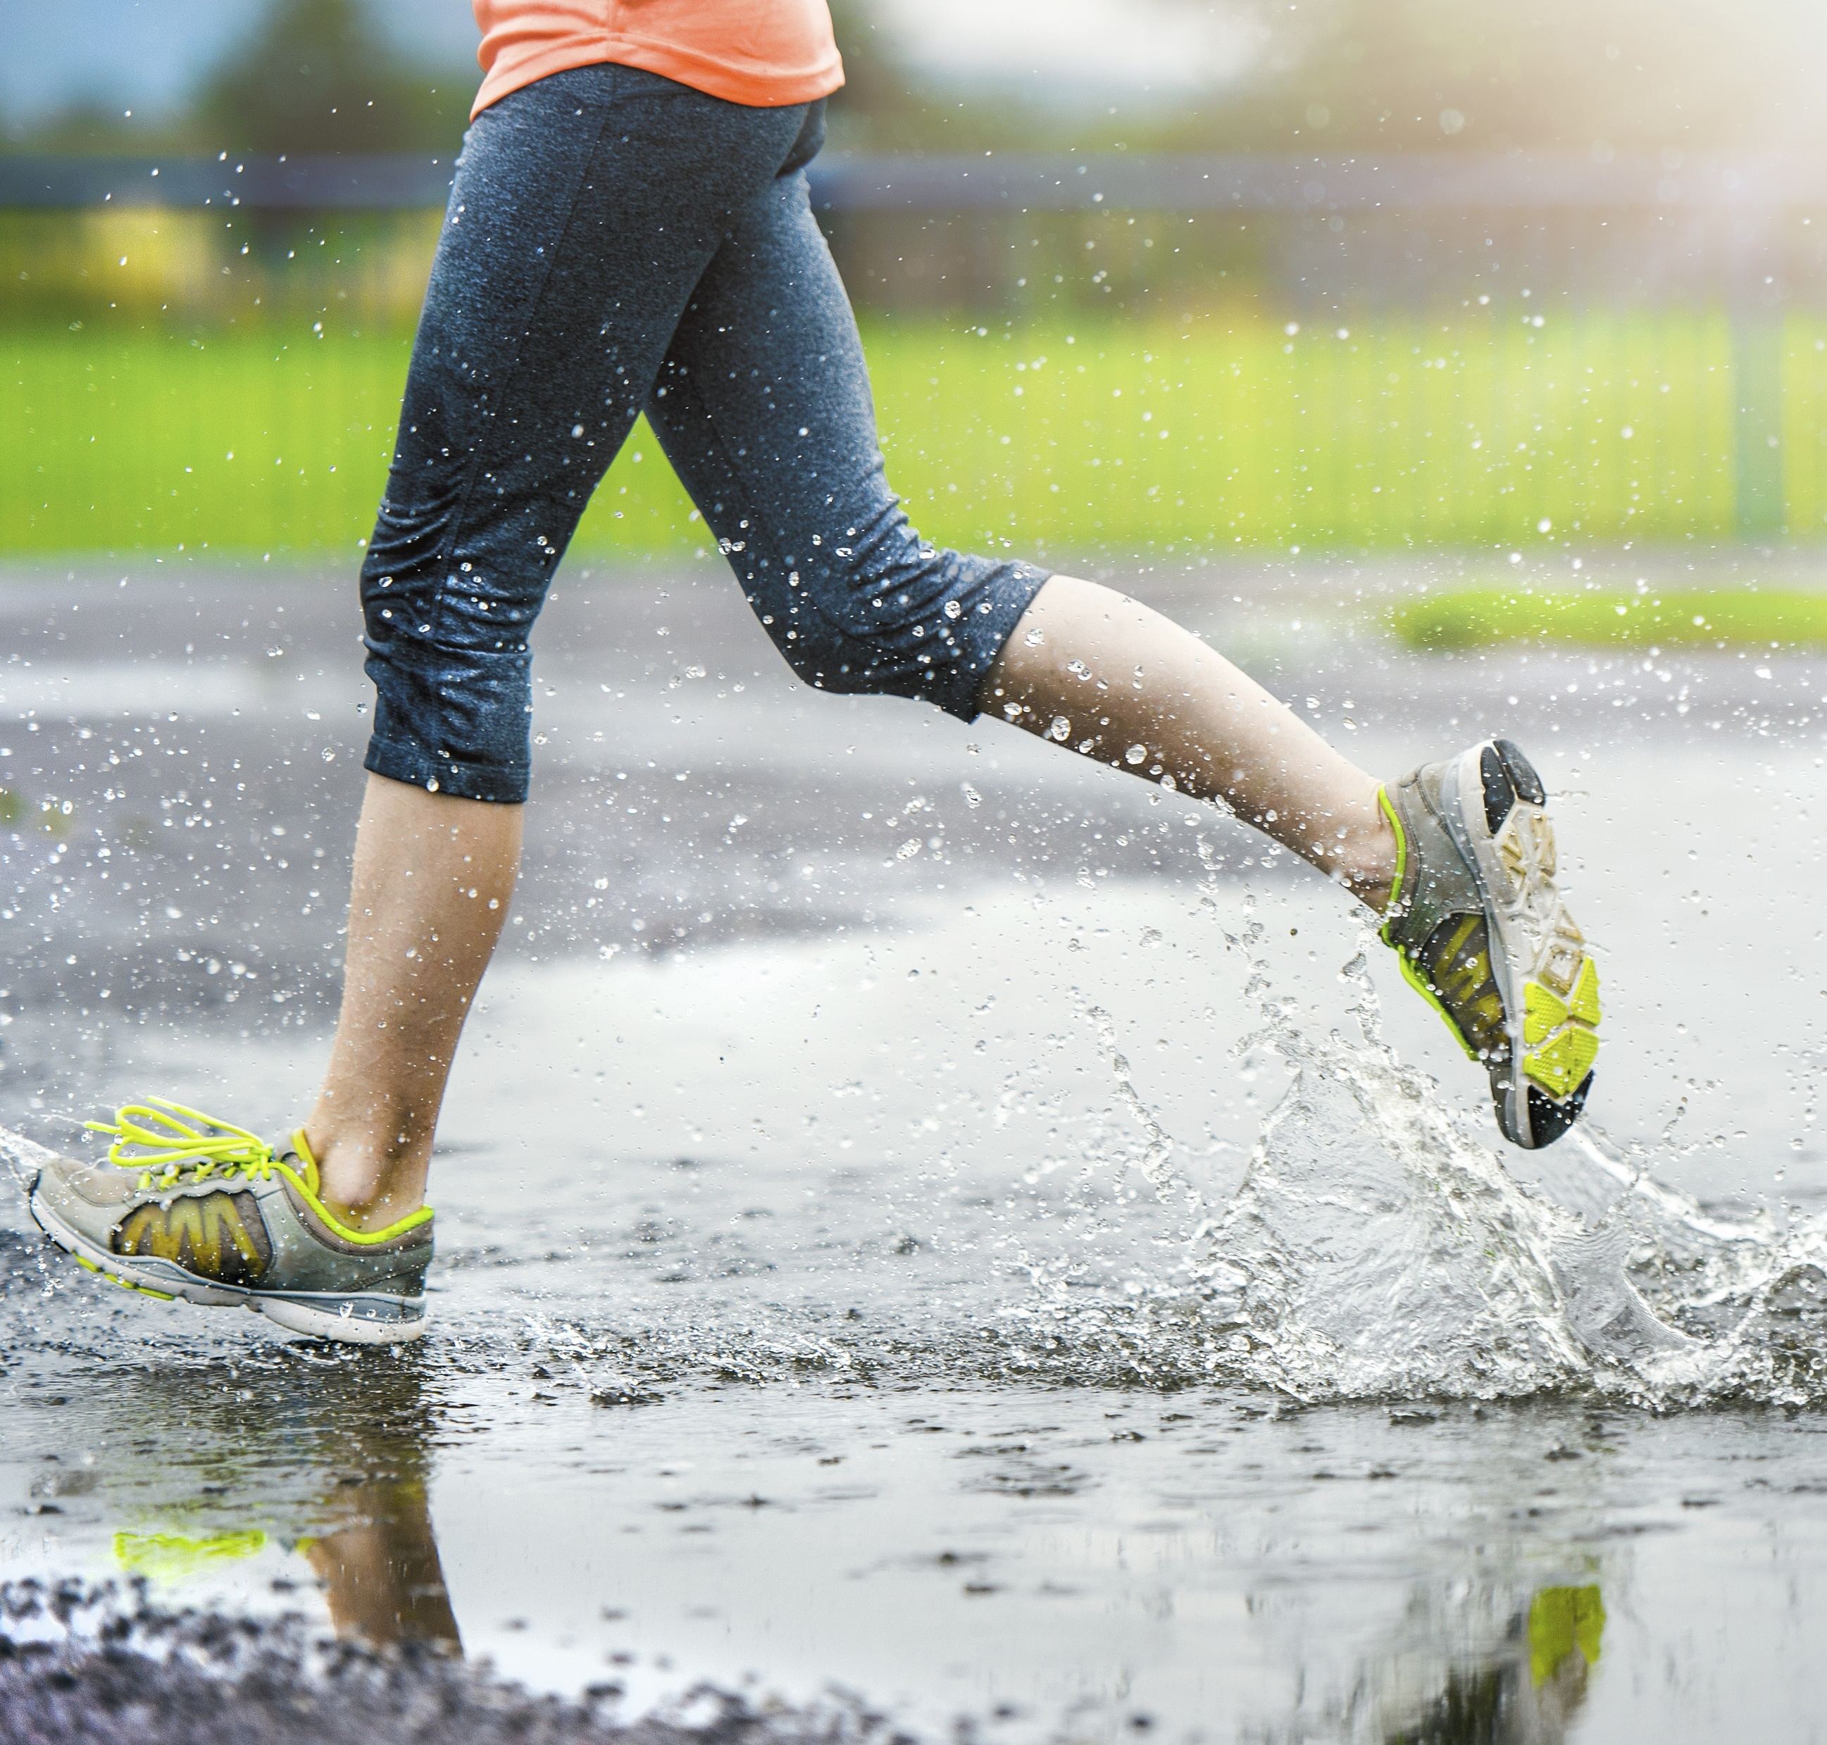
Conducting fitness tests
1
You need to assess the:
reliability
validity
practicality
of each fitness test.
Reliability
This is whether the test would give the same results if carried out again.

Slide 11
Conducting fitness tests
1
Reliability is affected by:
Motivation
Calibration of equipment
Conditions, e.g. weather
If the test has been carried out properly
Experience of person running the test
Here is a video discussing the reliability of some fitness tests.

Slide 12
Conducting fitness tests
1
Validity - this is deciding what conclusions you can draw from the test.
Some tests are more valid for particular sports than others
Some tests are more valid for certain positions in a sport
A test that recreates movements from a sport will be more valid for that sport.

Slide 13
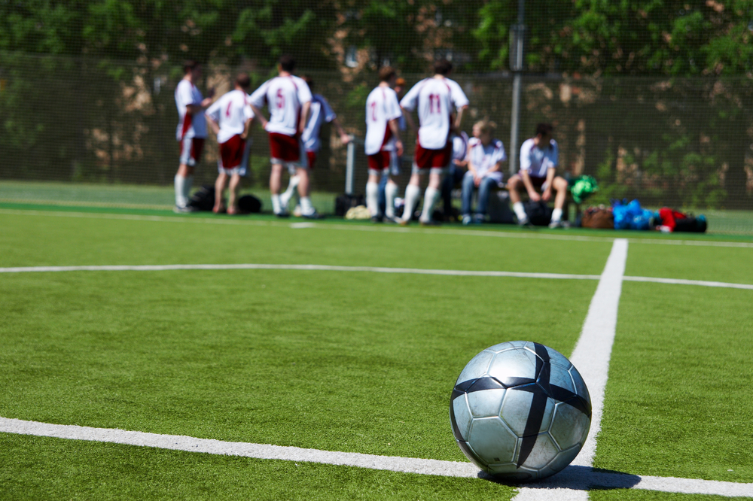
Conducting fitness tests
1
Practicality
To consider practicality you need to think about:
how much the test will cost to run
what equipment is available
how long the test will take to run
how many people can take the test at the same time
how long the results will take to process

Slide 14
Conducting fitness tests
1
Reliability, Validity and Practicality
Watch these two videos of the Illinois agility test.
Video 1 and Video 2
a) Are there any differences between the two tests? b) How might this affect reliability?
a) How valid is the test for lacrosse? b) What other sports would this test be valid for?
How practical do you think it is to run this test?

Slide 15
Summary
We now know:
About the reasons for fitness testing
There are pre-test procedures – things we need to do before carrying out a fitness test
There are standard test methods for each test
Tests need to be selected based on the participant and the reason for using the test
That test data have to measured and recorded carefully
That results have to be interpreted, often using published data
We need to assess each test for
reliability
validity
practicality

Slide 16
Quiz questions
Name two things that can affect the reliability of a fitness test
List two reasons why fitness tests are used
a) What is calibration? b) Give an example of calibration.
What is a PAR-Q form used for?
Why does a participant need to give informed consent?
What does validity mean?
What are the main things you need to run a fitness test?
Give two factors that can influence the practicality of a test.

